Slide 1
UM0016 Komunikasi Bisnis
Business Presentations

Slide 2
Overview
Chapter 5 learn about preparing presentation, during presentation, and after presentation

Slide 3
Chapter Objectives
Recognize various types of business presentations, and discuss two important first steps in preparing for any of these presentations.
Explain how to organize the introduction, body, and conclusion as well as how to build audience rapport in a presentation.
Understand visual aids and how to avoid ineffective PowerPoint practices.
Create an impressive, error-free multimedia presentation that shows a firm grasp of basic visual design principles.
Specify delivery techniques for use before, during, and after a presentation.

Slide 4
Contents
Preparing Effective Business Presentations
Organizing Content for Impact and Audience Rapport
Understanding Contemporary Visual Aids
Preparing Engaging Multimedia Presentations
Polishing Your Delivery and Following Up

Slide 5






Speaking Skills and Your Career
Speaking skills:
Can lead to career success
May increase opportunities for promotion
Are useful at every career stage
Are the most desired soft skill
sought in job applicants
©2016 Cengage Learning. All Rights Reserved. May not be scanned, copied or duplicated, or posted to a publicly accessible website, in whole or in part.
© helen cingisiz/Fotolia
Ch. 12 / Slide 3

Slide 6









Types of Business Presentations
Briefings: concise summary of an issue, proposal, or problem
Reports: informational or persuasive
Podcasts: prerecorded audio or video clip delivered online
Virtual Presentations: online meeting presentations with remote colleagues
Webinars: Web-based presentation for lectures, workshops, or seminars
©2016 Cengage Learning. All Rights Reserved. May not be scanned, copied or duplicated, or posted to a publicly accessible website, in whole or in part.
© raven/Fotolia
Ch. 12 / Slide 4

Slide 7








Knowing Your Purpose
What do you want your
listeners to
remember
or do?
What do you want to accomplish?
©2016 Cengage Learning. All Rights Reserved. May not be scanned, copied or duplicated, or posted to a publicly accessible website, in whole or in part.
Ch. 12 / Slide 5

Slide 8




Knowing Your Audience
Anticipate audience reaction
How to relate to their needs
What techniques will work
How to ensure they’ll
remember
©2016 Cengage Learning. All Rights Reserved. May not be scanned, copied or duplicated, or posted to a publicly accessible website, in whole or in part.
© denis_pc /Fotolia
Ch. 12 / Slide 6

Slide 9




Succeeding With Four Audience Types
Friendly
Neutral
Uninterested
Hostile
©2016 Cengage Learning. All Rights Reserved. May not be scanned, copied or duplicated, or posted to a publicly accessible website, in whole or in part.
© yuuen/Fotolia
Ch. 12 / Slide 7

Slide 10






Organization and Repetition
1 2 3
Tell them what you are going to tell them.
Tell them.
Tell them what you have told them.
©2016 Cengage Learning. All Rights Reserved. May not be scanned, copied or duplicated, or posted to a publicly accessible website, in whole or in part.
Ch. 12 / Slide 9

Slide 11


The Introduction
Capture listeners’ attention
and get them involved.
Identify yourself and build
your credibility.
Preview your main points.
©2016 Cengage Learning. All Rights Reserved. May not be scanned, copied or duplicated, or posted to a publicly accessible website, in whole or in part.
Ch. 12 / Slide 10

Slide 12






How to Capture Attention
?
Question
!!!
Startling fact
Three guys board a plane…
Joke
Once upon a time…
“I have a dream…”
Satisfaction guaranteed
Story Quotation A promise
©2016 Cengage Learning. All Rights Reserved. May not be scanned, copied or duplicated, or posted to a publicly accessible website, in whole or in part.
Ch. 12 / Slide 11

Slide 13




How to Build Credibility
Describe your position, knowledge, or education experience.
Dress professionally.
Maintain eye contact.
Connect with your audience.
©2016 Cengage Learning. All Rights Reserved. May not be scanned, copied or duplicated, or posted to a publicly accessible website, in whole or in part.
© denis_pc/Fotolia
Ch. 12 / Slide 12

Slide 14


Structuring the Presentation
The Body
Focus on a limited number of main points.
Develop each point with adequate explanation and details.
Use a clear organizational strategy, for example, chronological order or importance.
©2016 Cengage Learning. All Rights Reserved. May not be scanned, copied or duplicated, or posted to a publicly accessible website, in whole or in part.
Ch. 12 / Slide 13

Slide 15


The Conclusion
Summarize the presentation’s main themes.
Leave audience with a specific, noteworthy take-away.
Include a statement or closing thought that indicates you are finished.
©2016 Cengage Learning. All Rights Reserved. May not be scanned, copied or duplicated, or posted to a publicly accessible website, in whole or in part.
Ch. 12 / Slide 14

Slide 16






Building Audience Rapport
Effectiv e
Verbal Signpos
Nonverbal
_{Im}(a_{a}n_{g}alo_{e}gy_{r},_{y}
(prev_{t}i_{s}ewing,
_{M}(a_{e}tt_{s}ire_{s}, b_{a}o_{g}dy_{e}
simile, metaphor, personal anecdote, personalized statistics)
summarizing, switching directions)
movement, eye
contacst, facial
expressions)
©2016 Cengage Learning. All Rights Reserved. May not be scanned, copied or duplicated, or posted to a publicly accessible website, in whole or in part.
© mostafa fawzy/Fotolia, © leremy/Fotolia
Ch. 12 / Slide 15

Slide 17

Purposes of Good Visual Aids
Emphasize and clarify main points.
Improve comprehension and retention.
Increase audience interest.
Make speaker appear more professional,
better prepared, more persuasive.
Jog the speaker’s memory.
©2016 Cengage Learning. All Rights Reserved. May not be scanned, copied or duplicated, or posted to a publicly accessible website, in whole or in part.
© leremy/Fotolia
Ch. 12 / Slide 17

Slide 18


The Value of Visual Aids
“Tell me, I forget.
Show me, I remember.
Involve me, I understand.”
©2016 Cengage Learning. All Rights Reserved. May not be scanned, copied or duplicated, or posted to a publicly accessible website, in whole or in part.
© MelisendeVector.com/Fotolia
Ch. 12 / Slide 18

Slide 19



Types of Visual Aids
Multimedia
slides
Handouts
Zoom
presentations
©2016 Cengage Learning. All Rights Reserved. May not be scanned, copied or duplicated, or posted to a publicly accessible website, in whole or in part.
© Andrey/Fotolia, © mostafa fawzy/Fotolia
Ch. 12 / Slide 19

Slide 20


Preparing Engaging Multimedia Presentations
Analyzing the Situation and Purpose
Live presentation?
Self-running presentation at kiosk?
Saved on server to watch when convenient?
Self-contained file? Slide deck?
©2016 Cengage Learning. All Rights Reserved. May not be scanned, copied or duplicated, or posted to a publicly accessible website, in whole or in part.
Ch. 12 / Slide 21

Slide 21






Adjust Slide Design to Audience
Meaning of color
Power of images
Impact of special effects
©2016 Cengage Learning. All Rights Reserved. May not be scanned, copied or duplicated, or posted to a publicly accessible website, in whole or in part.
© denis_pc/Fotolia
Ch. 12 / Slide 22

Slide 22
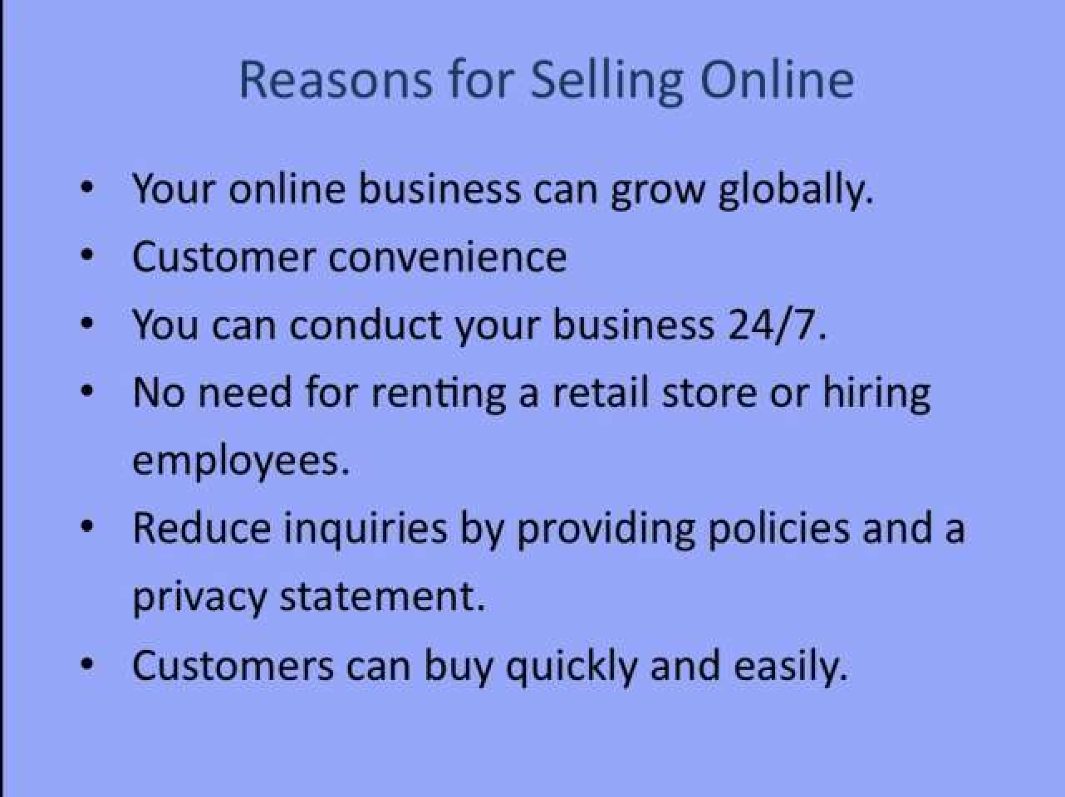
“Before” – Ineffective PowerPoint Slide
©2016 Cengage Learning. All Rights Reserved. May not be scanned, copied or duplicated, or posted to a publicly accessible website, in whole or in part.
Ch. 12 / Slide 23

Slide 23
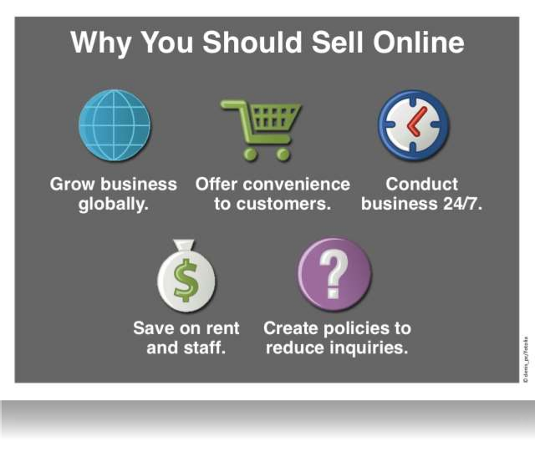
“After” – Improved PowerPoint Slide
©2016 Cengage Learning. All Rights Reserved. May not be scanned, copied or duplicated, or posted to a publicly accessible website, in whole or in part.
Ch. 12 / Slide 24

Slide 24






Seven Steps to a Powerful Multimedia Presentation
1
Focus on the text.
2
Select background and fonts.
3
Choose images that help
communicate your message.
4
Create graphics.
©2016 Cengage Learning. All Rights Reserved. May not be scanned, copied or duplicated, or posted to a publicly accessible website, in whole or in part.
Ch. 12 / Slide 25

Slide 25


Seven Steps to a Powerful Multimedia Presentation
5
Add special effects.
6
Create hyperlinks.
7
Move your presentation online.
©2016 Cengage Learning. All Rights Reserved. May not be scanned, copied or duplicated, or posted to a publicly accessible website, in whole or in part.
Ch. 12 / Slide 26

Slide 26






Choose a Delivery Method
Reading From Notes
Extemporaneous Method
Memorization
©2016 Cengage Learning. All Rights Reserved. May not be scanned, copied or duplicated, or posted to a publicly accessible website, in whole or in part.
© yuuen/Fotolia
Ch. 12 / Slide 28

Slide 27




Does Public Speaking Scare You?
“According to most studies, people’s number one fear is public speaking. Number two fear is death. Death is number two!!! Now, this means, to
the average person, if you have to go to a funeral, you're better off in the casket than doing the eulogy.”
— Jerry Seinfeld monologue, episode 61 of Seinfeld
©2016 Cengage Learning. All Rights Reserved. May not be scanned, copied or duplicated, or posted to a publicly accessible website, in whole or in part.
© photo copyrights here
Ch. 12 / Slide 29

Slide 28

Combat Stage Fright
Breathe deeply.
Convert your fear.
Know your topic and come prepared.
Use positive self-talk.
©2016 Cengage Learning. All Rights Reserved. May not be scanned, copied or duplicated, or posted to a publicly accessible website, in whole or in part.
© leremy/Fotolia
Ch. 12 / Slide 30

Slide 29
Combat Stage Fright
Take a sip of water.
Shift the spotlight to your visuals.
Ignore any stumbles.
Feel proud when you finish.
©2016 Cengage Learning. All Rights Reserved. May not be scanned, copied or duplicated, or posted to a publicly accessible website, in whole or in part.
© leremy/Fotolia
Ch. 12 / Slide 31

Slide 30

Before Your Presentation
Prepare thoroughly.
Rehearse repeatedly.
Time yourself.
Dress professionally.
©2016 Cengage Learning. All Rights Reserved. May not be scanned, copied or duplicated, or posted to a publicly accessible website, in whole or in part.
© leremy/Fotolia
Ch. 12 / Slide 32

Slide 31
Before Your Presentation
Request a lectern.
Check the room.
Greet audience members.
Practice stress reduction.
©2016 Cengage Learning. All Rights Reserved. May not be scanned, copied or duplicated, or posted to a publicly accessible website, in whole or in part.
© leremy/Fotolia
Ch. 12 / Slide 33

Slide 32

During Your Presentation
Begin with a pause.
Present your first line from memory.
Maintain eye contact.
Don’t read from
your notes.
Control your voice and avoid meaningless fillers.
©2016 Cengage Learning. All Rights Reserved. May not be scanned, copied or duplicated, or posted to a publicly accessible website, in whole or in part.
© leremy/Fotolia
Ch. 12 / Slide 34

Slide 33
During Your Presentation
Show enthusiasm.
Skip the apologies.
Slow down.
Know when to pause
on important points.
Do not read from the
slides.
©2016 Cengage Learning. All Rights Reserved. May not be scanned, copied or duplicated, or posted to a publicly accessible website, in whole or in part.
© leremy/Fotolia
Ch. 12 / Slide 35

Slide 34
During Your Presentation
Move naturally.
Use verbal aids effectively.
Avoid digressions.
Summarize your
main points, and
drive home your main idea.
©2016 Cengage Learning. All Rights Reserved. May not be scanned, copied or duplicated, or posted to a publicly accessible website, in whole or in part.
© leremy/Fotolia
Ch. 12 / Slide 36

Slide 35





After Your Presentation
Repeat
questions.
Distribute
handouts.
Reinforce your main points.
Encourage
questions.
©2016 Cengage Learning. All Rights Reserved. May not be scanned, copied or duplicated, or posted to a publicly accessible website, in whole or in part.
© leremy/Fotolia
Ch. 12 / Slide 37

Slide 36



After Your Presentation
End with a summary and appreciation.
Do not become defensive.
Avoid Yes, but answers.
©2016 Cengage Learning. All Rights Reserved. May not be scanned, copied or duplicated, or posted to a publicly accessible website, in whole or in part.
© leremy/Fotolia
Ch. 12 / Slide 38

Slide 37
Question & Answers

